Slide 1
Fair Trade Bags from Bangladesh
Action Bags
The story behind each bag

Slide 2
What is Fair Trade?
Producers and farmers are paid a fair price for their products and receive social benefits for their local community

Slide 3
Action Bag
One Fair Trade company is Action Bag in the town of Saidpur in northern Bangladesh.
Action Bag was set up in 1976 to help the millions of women and children living in refugee camps in and around Saidpur, India.

Slide 4
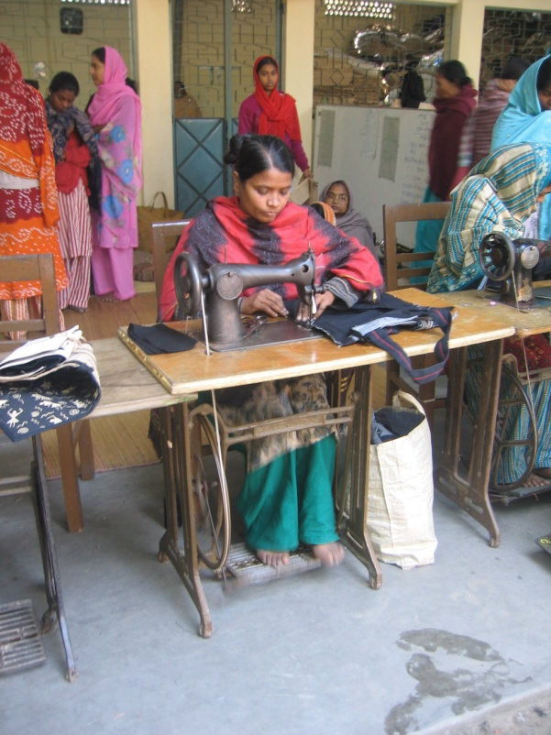
Action Bag
Action Bag teaches women how to make bags out of cotton or jute – a locally sourced product.
This enables the women to get enough money to make a living, feed their children and pay for them to go to school.

Slide 5
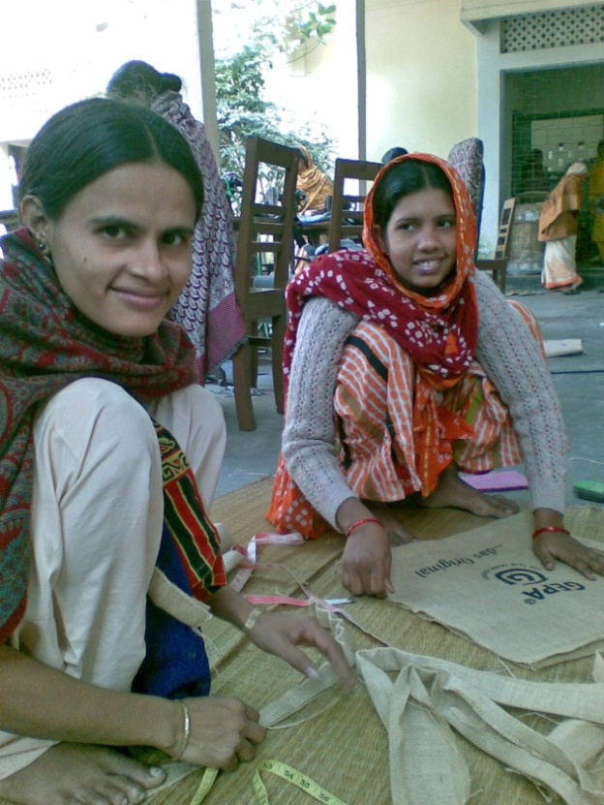
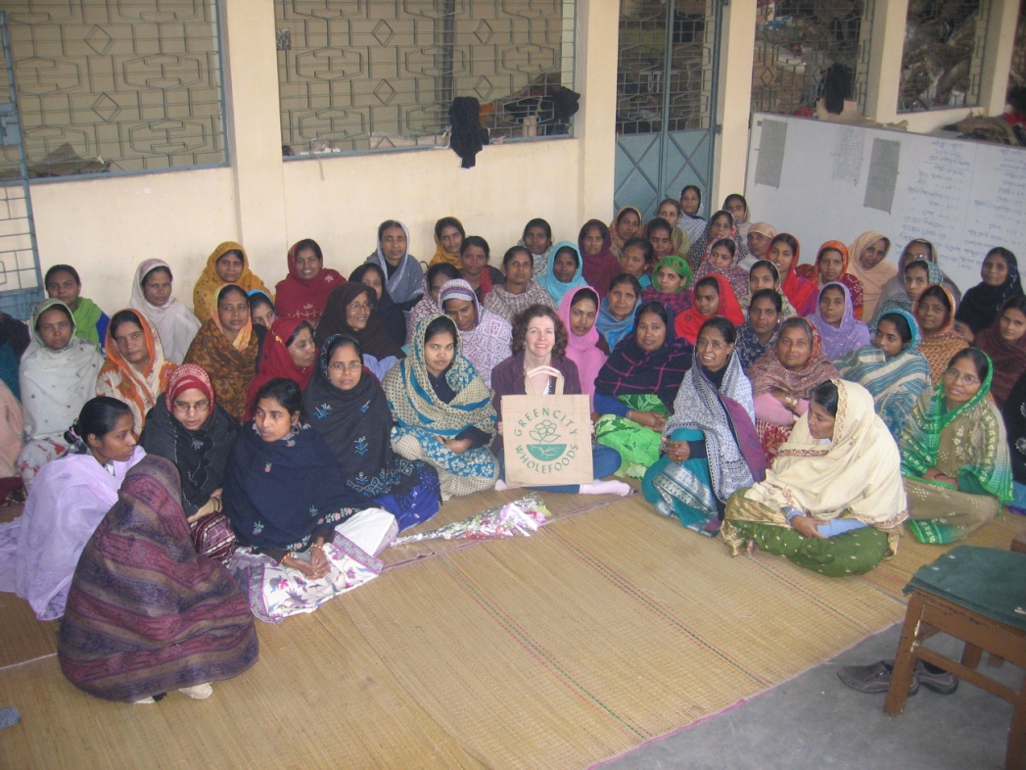
Action Bag
Today the project employs 70 women
The bags are sold across the world to fair trade organisations such as One World Shop
This photo shows our Business Manager, Rachel, with some of the women from
Action Bag

Slide 6
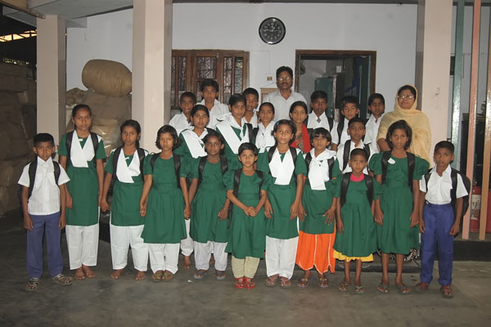
How does Fair trade make a difference?
Action Bag
The workers have good working conditions
Once a year each worker receives a special bonus and share of the annual profits.
Each worker’s child who needs it receives a free school bag and uniform.

Slide 7
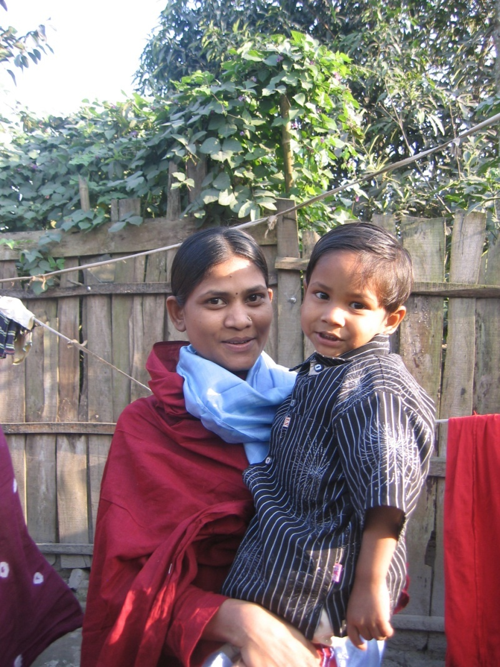
Personal Stories - Regina
Action Bag
Regina has been working at Action Bag for just 6 months, she is 22 years old. She has a young son and is able to support him and her family with the money she earns.
She has been able to buy a new bed and clothes for her 3 year old son. Before working there she only had one dress and could not afford food to feed her son. When the annual bonus comes she is planning to install electricity in their home for the first time.

Slide 8
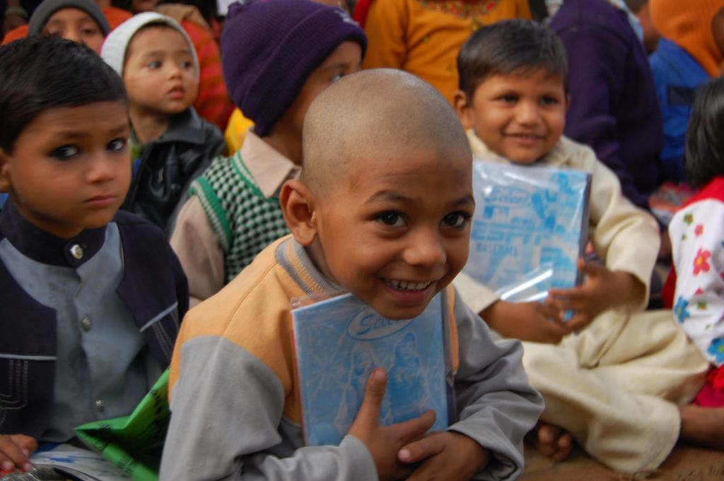
Action Bag
If you buy a fair trade bag from Action Bag, your purchase is making a real difference in helping people out of poverty.

Slide 9
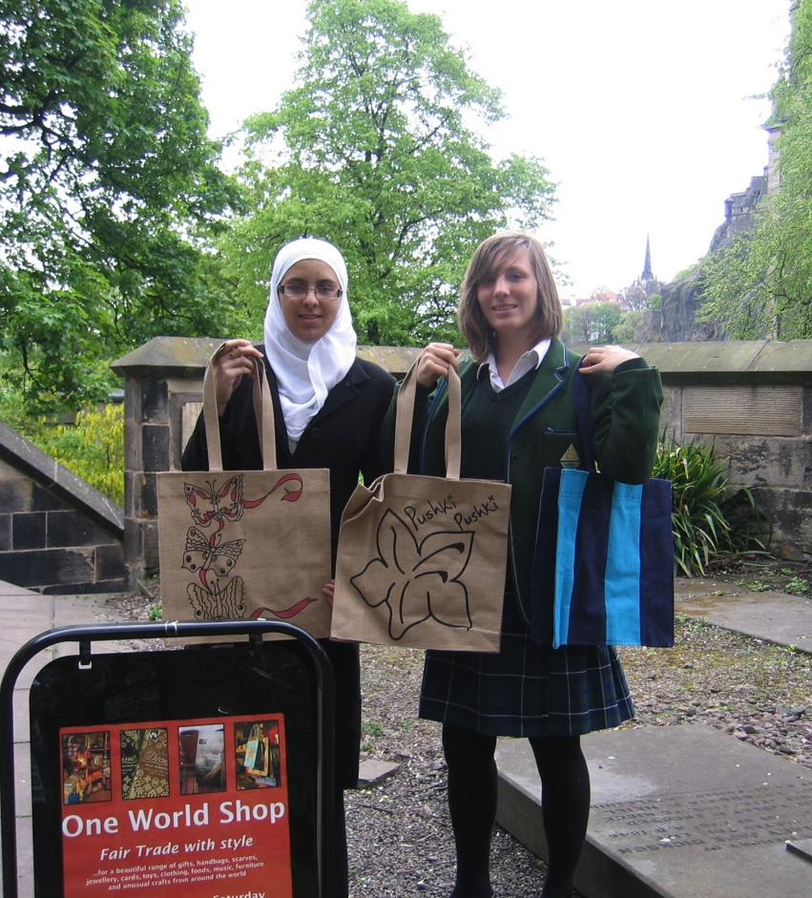
What can you do?
Action Bag
You can buy Fair Trade Action bags from your local One World Shop.
You can help design a fair trade bag for your school and enter our competition.
You can sell the bags to your friends, teachers and families.

Slide 10
One World Shop
Contact the One World Shop for more details at:
649 Great Western Road
Glasgow
G12 8RE
Tel: 0141 337 6117
Email: elaine@oneworldshop.co.uk
www.oneworldshop.co.uk

